Slide 1
Frequency Hopping Spread Spectrum
By Deepali (MCA 5th Sem)

Slide 2
Spread Spectrum
Spread Spectrum is a technique in which the transmitted signals of specific frequencies are varied slightly to obtain greater bandwidth as compared to initial bandwidth.

Slide 3
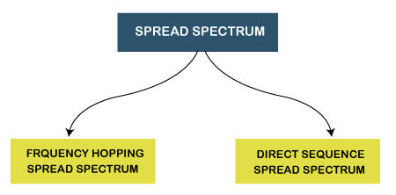
Types of Spread Spectrum

Slide 4
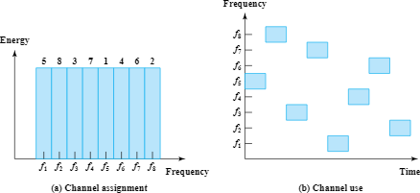
What is FHSS ?
Frequency-hopping spread spectrum is designed for robust operation in noisy environments by transmitting short packets at different frequencies across wide portions of channel bandwidth.

Slide 5
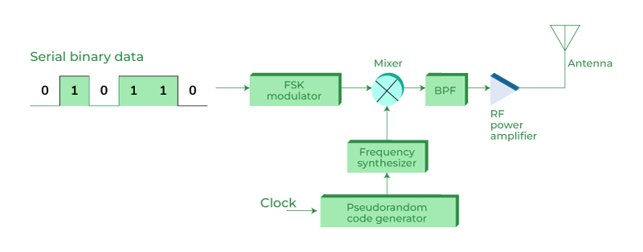
Fig. Block Diagram of FHSS (Transmitter side)

Slide 6
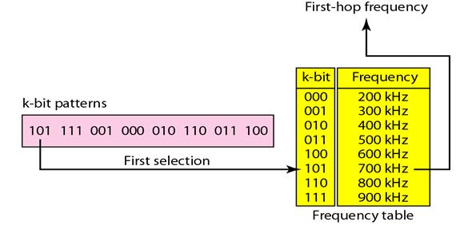

Slide 7
How does it work ?
For transmission, binary data is fed into a modulator using some digital-to-analog encoding scheme, such as Frequency Shift Keying (FSK) or Binary Phase Shift Keying (BPSK).
A PN source serves as an index into a table of frequencies each K bit on the PN source specifies one of the 2k carrier frequencies.
At each successive interval, a new carrier frequency is selected.
This frequency is then modulated by the signal produced from the initial modulator to produce a new signal with the same shape.
On reception, the spread spectrum signal is demodulated using the same sequence of PN-derived frequencies and then demodulated to produce the output data.

Slide 8
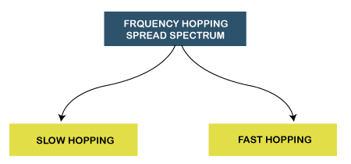
Types of FHSS
Slow Hopping: In slow hopping, multiple bits are transmitted on a specific frequency or same frequency.
Fast Hopping: In fast hopping, individual bits are split and then transmitted on different frequencies.

Slide 9
Advantages
High efficiency.
Highly resistant to narrowband interference
Requires a shorter time for acquisition.
Highly secure. Its signals are very difficult to intercept if the frequency-hopping pattern is not known.
It provides a very large bandwidth.

Slide 10
Disadvantages
Less Robust, so sometimes it requires error correction.
Needs complex frequency synthesisers.
Supports a lower data rate of 3 Mbps as compared to the 11 Mbps data rate supported by DSSS.

Slide 11
Applications
Used in wireless local area networks (WLAN) standard for Wi-Fi.
Used in the wireless personal area networks (WPAN) standard for Bluetooth.

Slide 12
References
https://www.javatpoint.com/spread-spectrum-in-mobile-computing
https://www.ques10.com/p/65187/draw-the-block-diagram-of-fhss-transmitter-and-r-1/
https://www.geeksforgeeks.org/frequency-hopping-spread-spectrum-in-wireless-networks/
https://www.youtube.com/watch?v=PUQMKrtUYz8
https://www.youtube.com/watch?v=f4qblYxEEHM

